Slide 1




LIBRARY MANAGEMENT SYSTEM
BBS COLLEGE OF ENGINEERING & TECHNOLOGY
SUBMITTED TO
Mr. AMAN SHARMA SIR

Slide 2


WELCOME
In Our Group Project :
Library Management System

Slide 3


﻿About Us
Developed & Designed By:
VISHAL MUNSHI
ROSHAN PATEL
AKASH YADAV

Slide 4

Introduction to Library Management Systems
A library management system is a digital platform used to efficiently manage the resources, services, and operations of a library. It includes functions such as cataloging, circulation, and user management.

Slide 5
ABSTRACT
Library management system is a project which aims in developing a computerized system to maintain all the daily work of library .This project has many features which are generally not available in normal library management systems like facility of user login and a facility of admin login .It also has a facility of admin login through which the admin can monitor the whole system . It has also a facility where student after logging in their accounts can see list of books issued and its issue date and return date.
Overall, this project of ours is being developed to help the students as well as staff of library to maintain the library in the best way possible and also reduce the human efforts.

Slide 6
Background of the Project
Library Management System is an application which refers to library systems which are generally small or medium in size. It is used by librarian to manage the library using a computerized system where he/she can record various transactions like issue of books, return of books, addition of new books, addition of new students etc.
Books and student maintenance modules are also included in this system which would keep track of the students using the library and also a detailed description about the books a library contains. With this computerized system there will be no loss of book record or member record which generally happens when a non-computerized system is used.
All these modules are able to help librarian to manage the library with more convenience and in a more efficient way as compared to library systems which are not computerized.

Slide 7

Benefits of Using a Library Management System
1
Efficient Resource Management
2
Data-Driven Decision Making
3
Improved User Experience
Streamlines the organization and tracking of library materials, enhancing accessibility for patrons.
Provides valuable insights through analytics, aiding in informed collection development and resource allocation.
Enables patrons to easily find and borrow materials, enhancing overall satisfaction and engagement.

Slide 8

PROJECT
MODULE
1
Admin
2
Users (students)

Slide 9
Admin Module
Secure admin login system
Admin Dashboard
Admin can add/update/ delete category
Admin can add/update/ delete author
Admin can add/update/ delete books
Admin can issue a new book to student and also update the details when student return book
Admin can search student by using their student ID
Admin can also view student details
Admin can change own password

Slide 10
User (Student) Module
Student can register yourself and after registration they will get student id
After login student can view own dashboard.
Student can update own profile.
Student can view issued book and book return date-time.
Student can also view the available books in the library.
Student can also change own password.
Student can also recover own password .

Slide 11
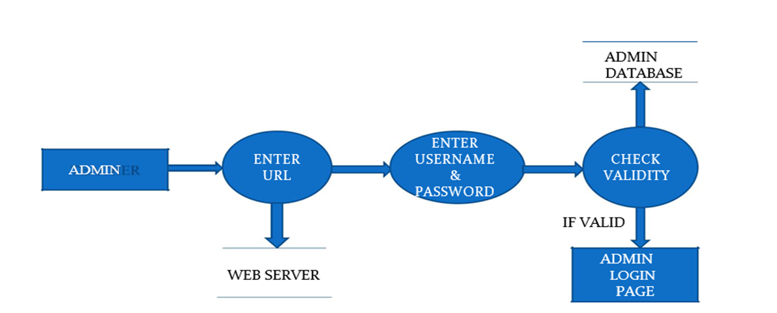
Use Case Diagram
After entering to the home page of the website , Admin can choose the ADMIN LOGIN option where they are asked to enter username & password , and if he/she is a valid user then a admin dashboard will be displayed

Slide 12
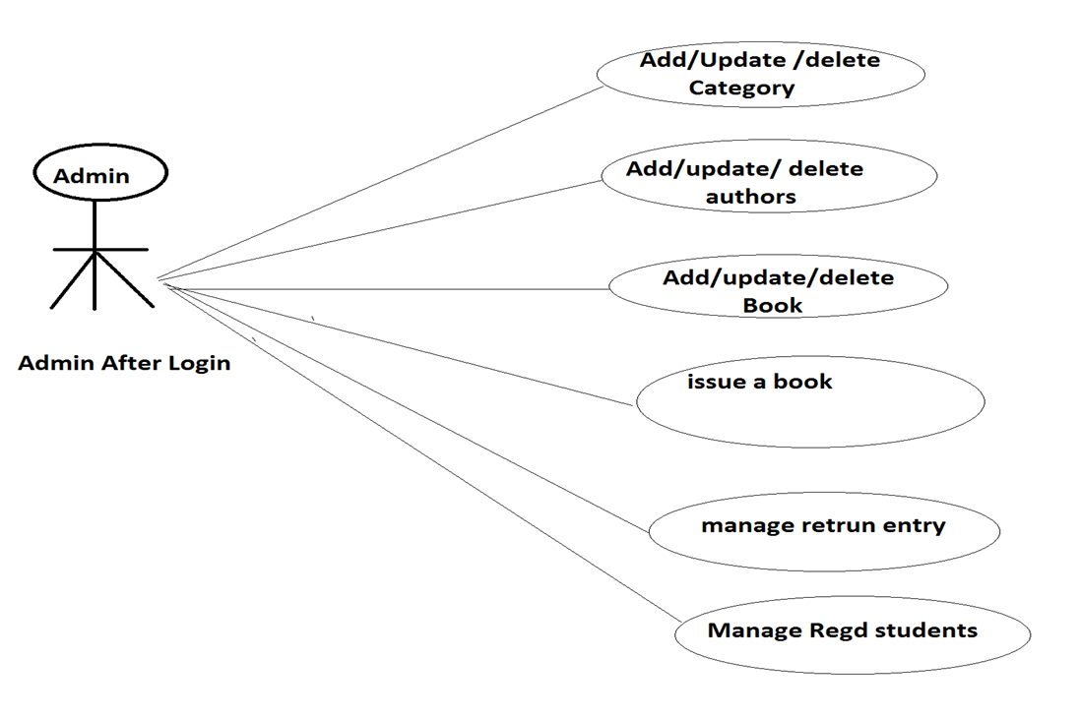
Admin DFD

Slide 13
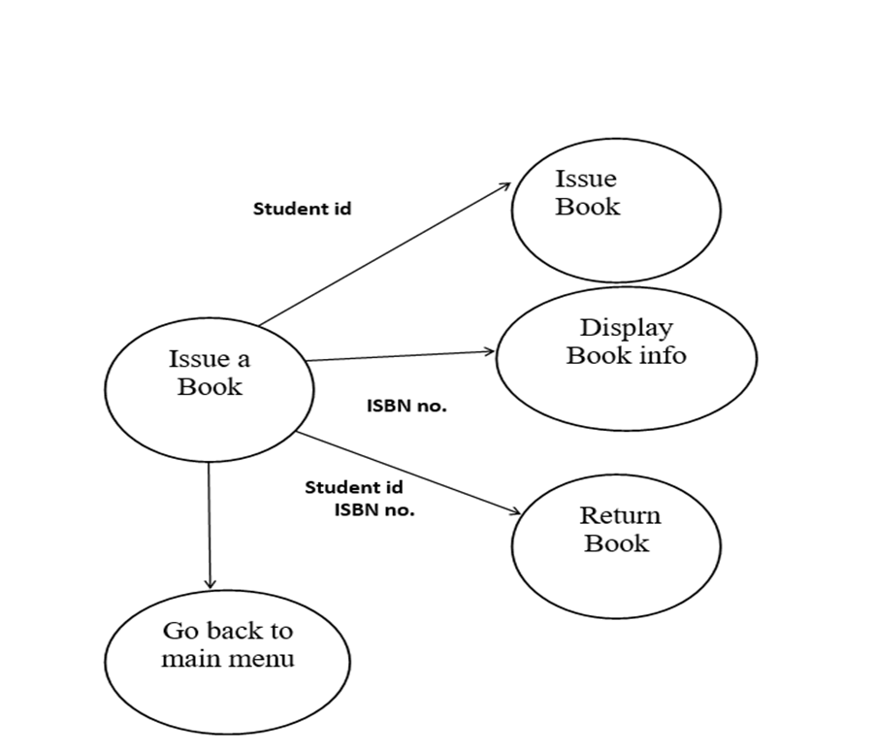

Slide 14
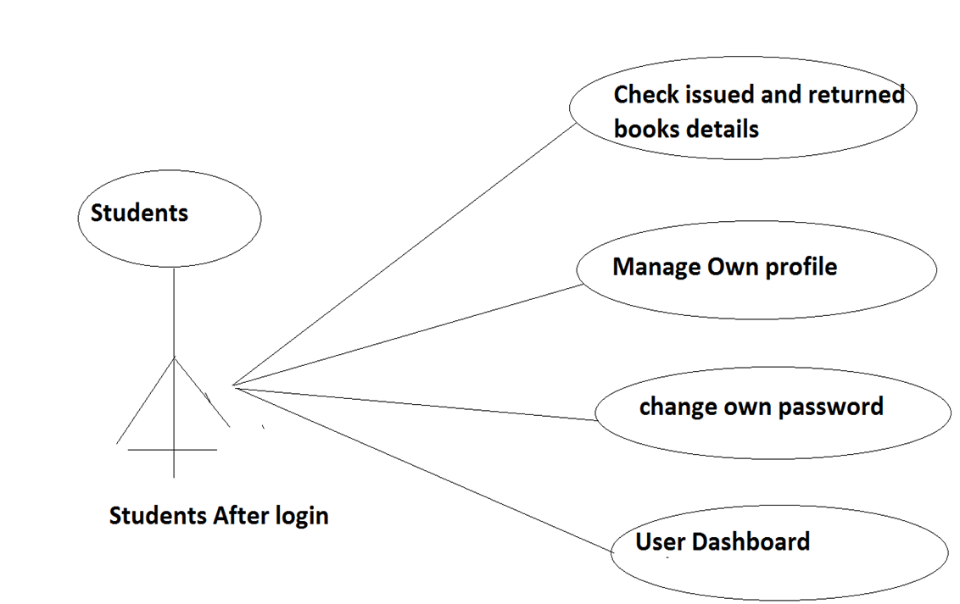
DFD For Students

Slide 15




Cataloging and Classification of Library Materials
Data Entry
Inputting detailed information about library materials, including author, title, subject, and other relevant metadata.
Classification
Organizing materials according to established classification systems for efficient retrieval and user access.
Metadata Management
Maintaining and updating comprehensive metadata records to ensure accurate and thorough information for each resource.

Slide 16

Challenges and Considerations in Implementing a Library Management System
1
Training and Adoption
2
Data Migration
Ensuring comprehensive training programs for library staff to promote effective system adoption and usage.
Addressing the complexities of migrating existing library data to the new system while maintaining accuracy and integrity.
3
Change Management
Managing organizational changes and user transitions to ensure a smooth and positive implementation experience.

Slide 17


